Slide 1

National Technical University "Kharkiv Polytechnic Institute" Department "Software engineering and management intellectual technologies« Thesis on theme: DESIGN AND DEVELOPMENT OF SOFTWARE COMPONENTS OF THE HR MANAGEMENT SERVICE CHATBOT
Performer:​
Student of the group KN219ib.e Yagiz Bora Yamali
Project Director:
Associate Proffesor SEMIT Deparment Alexander Shmatko
Kharkiv 2023

Slide 2
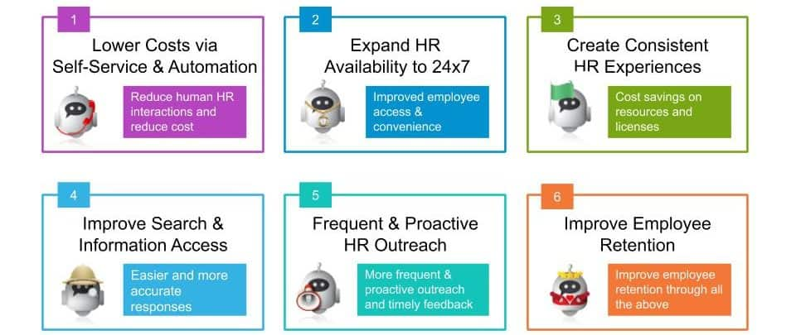
Relevance of the work
Notes:
Employee chatbots and natural language processing technology are changing the face of today’s human resources management and providing new opportunities to enhance employee engagement and automate key HR processes
A chatbot is artificial intelligence (AI) software that uses natural language processing to imitate a human conversation with a user using voice-activated interfaces, websites, mobile apps, and messaging services. A good HR chatbot is more than just a simple question-and-answer bot. Based on its understanding of the employee’s intent, an HR chatbot can automate repetitive duties and procedures, which is its real value. The advantages of using a chatbot in the personnel service are presented on the slide. Thus, the topic of my work is relevant

Slide 3
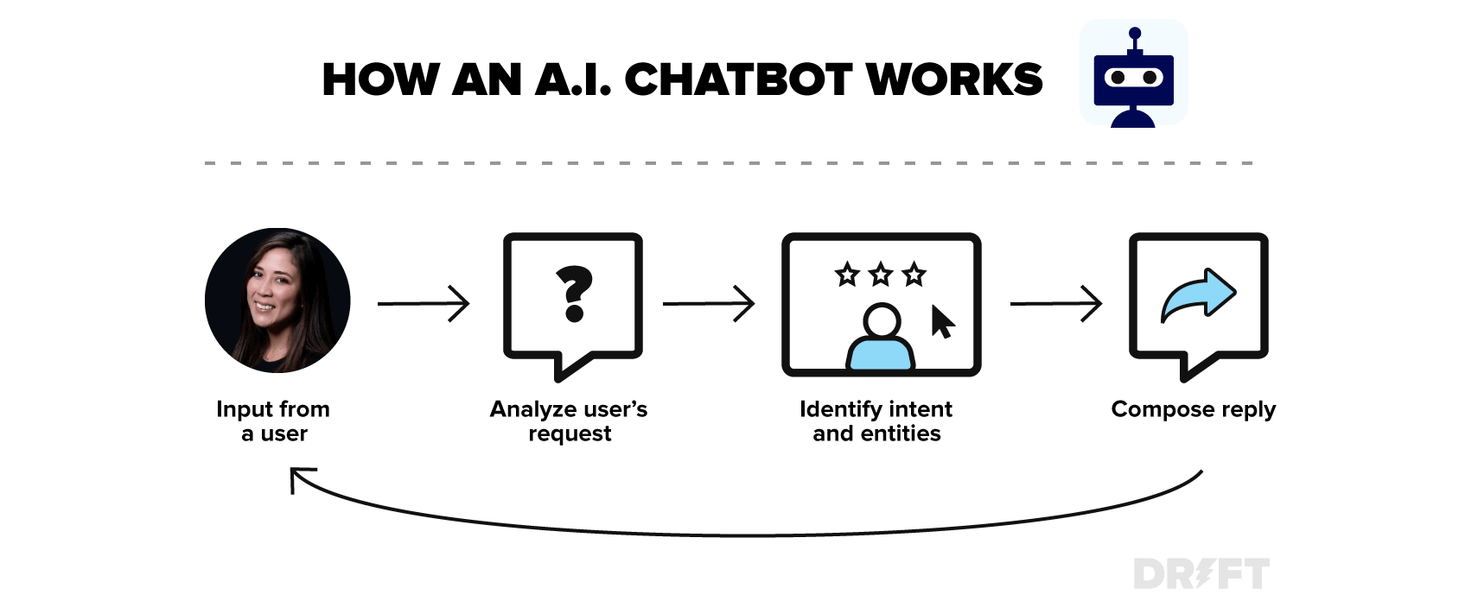
Chatbots. Basic concepts and definitions
Chatbots are chatbots that users communicate with as if they are writing to a human through messaging in the digital environment and that they use for various purposes such as getting information about a subject and taking action. Using a chatbot, it is possible to order pizza, buy movie tickets, check-in for flight, find out account balance.

Slide 4
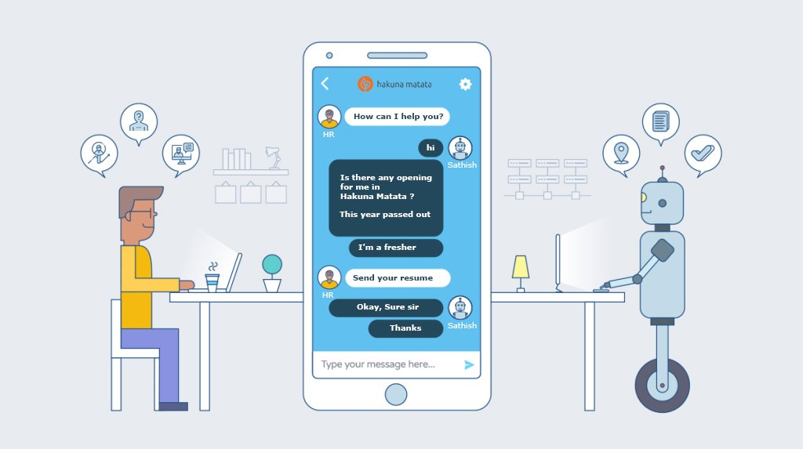
What is a Chatbot?
1-Basic Chatbot:
Notes:
There are 2 Types of Chatbots
1-Basic Chatbot:
In simple chats, the chatbot works based on pre-written keywords. Each of these given commands must be written separately by the developer using regular expressions or other forms of string analysis.
If the user has asked a question without using a single keyword, the robot cannot understand it and, as a rule, responds with messages such as "sorry, I don't understand".

Slide 5
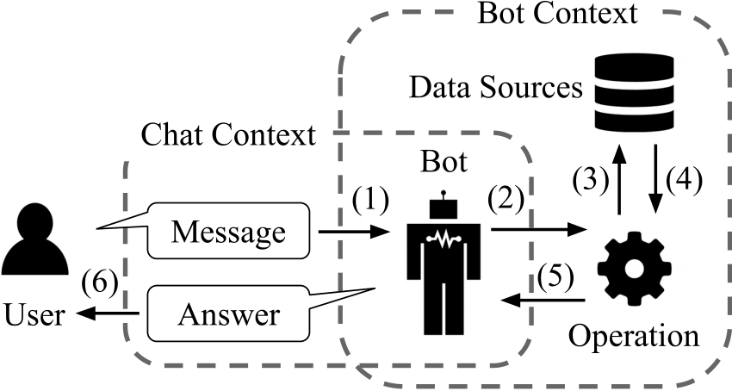
Artificial Intelligence Powered Chatbot
Notes:
Intelligent chatbot relies on artificial intelligence when communicating with users. Instead of pre-prepared answers, the robot gives satisfactory answers on the topic. Also, all words spoken by users are saved for further processing.

Slide 6
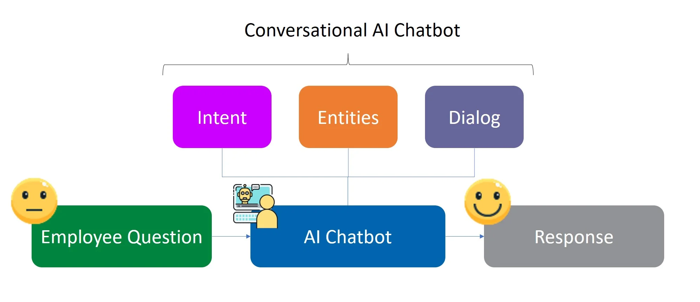
Using chatbots in the context of human resource
Notes:
The World Wide Web is becoming too crowded with various information where it is getting harder for the user to find information that they need.
Usually employee or people needs to go through a long list of question and answers in a website support page in order to find out about solutions to problems that they are facing.
In order to increase the ease of the user and the support team, the interaction with any sort of system, human or artificial intelligence (AI) is required.
With the advancement of intelligent systems, machines have started to impersonate different
human traits.

Slide 7
Purpose, object and subject of research
The Purpose of the work: Reducing the workload on human resources and answering frequently asked questions with chatbot
This object answers questions with chatbot
The Subject Development and design of chatbot for human resources

Slide 8
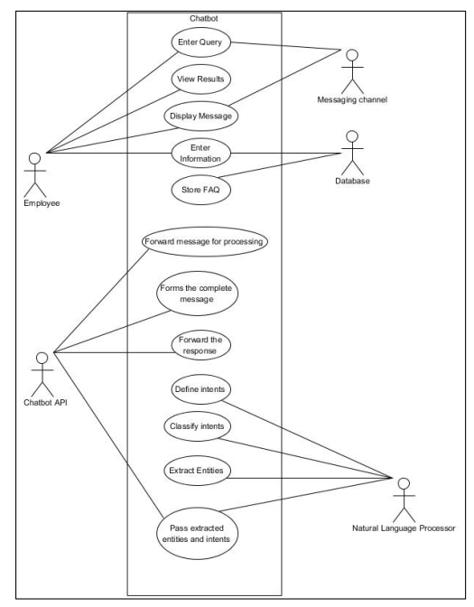
Chatbot for Employee Use Case Diagram
Notes:
Figure shows the main components of this chatbot system is labelled as actors. There is a total of five actors which are employee, chatbot API, messaging channel, database and natural language processing.
The employee can enter query, view results, display message and enter information.
The messaging channel acts as a middleware to get the query and display replies.
The database stores the information and also stores the FAQs.
The chatbot API forwards message of the employee to the database, forms a complete message, forwards the response to the employee.
The natural language processing defines intents, extract entities and pass the extracted entities and intents to the chatbot API.

Slide 9
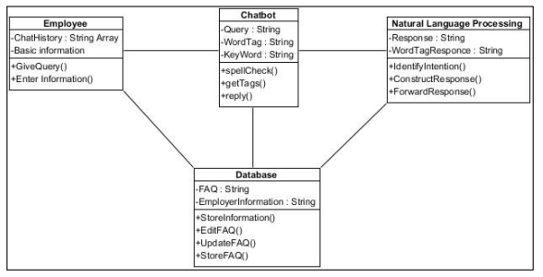
Chatbot for Employee Class Diagram
Notes:
Figure on this slide shows the different classes in the chatbot for employee system. There are four classes which are employee class, chatbot class, natural language processing class and database class. The employee class stores the chat history in an array and basic information of employee. This employee class is where the method of giving a query and entering information. The chatbot class contains the queries and identified word tags and keywords.

Slide 10
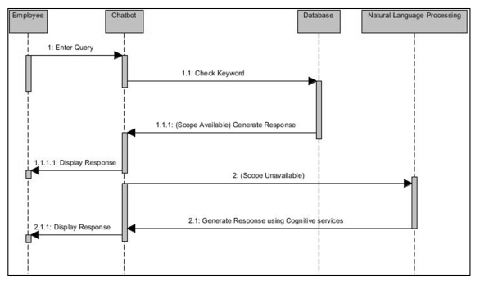
Chatbot for Employee Sequence Diagram
Notes:
Figure shows the different classes in the chatbot for employee system. There are four classes which are employee class, chatbot class, natural language processing class and database class. The employee class stores the chat history in an array and basic information of employee. This employee class is where the method of giving a query and entering information. The chatbot class contains the queries and identified word tags and keywords.

Slide 11
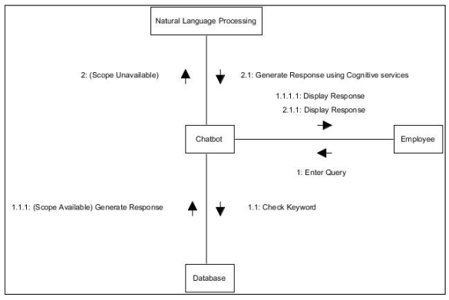
Chatbot for Employee Communication Diagram
Notes:
is the communication diagram of chatbot for employee. The employee enters a query. The chatbot check for keyword of the question in the database. If the scope is available a response is generated. If the scope is unavailable the natural language processing analyses the question and generates response using cognitive services. The chatbot sends the request and the response is displayed to the employee.

Slide 12
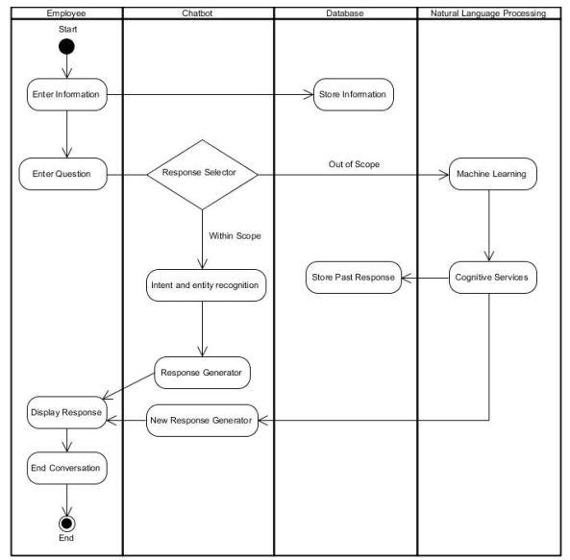
Chatbot for Employee Activity Diagram
Notes:
Figure shows an activity diagram of chatbot for employee. Firstly, the employee starts the process by either entering an information or entering a question. The information entered is stored in the database while the question entered goes to the chatbot where two outcomes can be made, either the question asked is within the scope or it is out of scope. If the question is within scope the chatbot uses intent and entity recognition to generate a response. If the question is out of scope the natural processing language uses machine learning and cognitive services to generate a new response. At the same time these new responses are stored in the database for future use. Lastly, the response is displayed to the employee.

Slide 13
Testing Plan of System Testing
NO | Test | Objective | Test Input | Results
1. | Launching of web application | To determine the website is functional. | Scan website QR code. | Website launches.
2. | Testing Webhooks | To determineif the Chatbot is connected to the website. | Type a test message in website. | Chatbot able to reply.
3. | Test integration with Facebook Messenger | To determine if the Azure Chatbot created is able to connect to Facebook Developer. | Type test message. | Chatbot able to reply.
4. | Test Chatbot with various queries. | To determine if the Chatbot is able to perform as expected. | Type various questions. | Chatbot able to determine the best answer.
Notes:
The test is a documentation with details of objectives, target market, beta team and processes for a specific beta test for the software or hardware product. The plan consists of a detailed plan of the eventual workflow. A test plan is to ensure that the product or system meets its design specifications and requirements Testing Plan of System Testing is presented on this slide

Slide 14
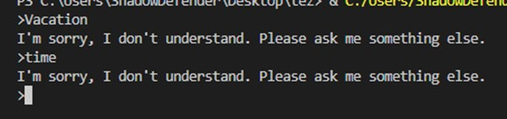
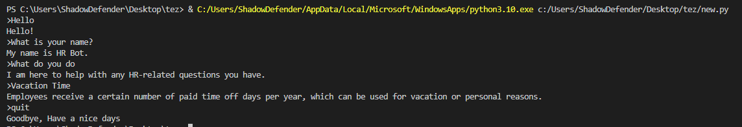
Chatbot Testing
Chatbot wrong input
Chatbot correct question and answer output
Notes:
The Bot framework emulator is a desktop application that allows you to test and debug your bots both locally and remotely. Using the emulator, the functionality of communication with the chatbot was tested. The test results are presented on the slides

Slide 15
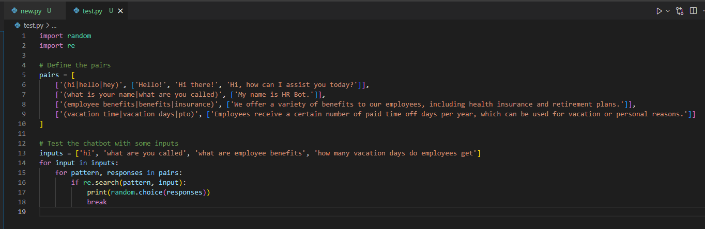
Test code with input

Slide 16
Conclusions
Chatbot AI for HR refers to the use of artificial intelligence and chatbot technology to improve HR services and streamline HR-related tasks
01
One of the main benefits of chatbot AI for HR is that it allows HR teams to automate many routine tasks, such as answering common employee questions, scheduling interviews, and providing feedback to employees
02
Chatbot AI for HR can also be used to improve the recruitment process by automating the screening of candidate resumes, scheduling interviews, and providing feedback to candidates
03
Another benefit of chatbot AI for HR is that it can be used to improve the onboarding process for new employees
04
Chatbot AI for HR can also be used to improve employee training and development.
05

Slide 17
Thank you for listening to me!

